Slide 1
DAY 1
TASK 2: DOTNET FRAMEWORK
Till current version
BY – Lakshita Garg

Slide 2

INTRODUCTION
It is an essential component of the Windows OS, that helps in creating applications by integrating different programming languages such as c#, visual basic, j#, visual C++.

Slide 3
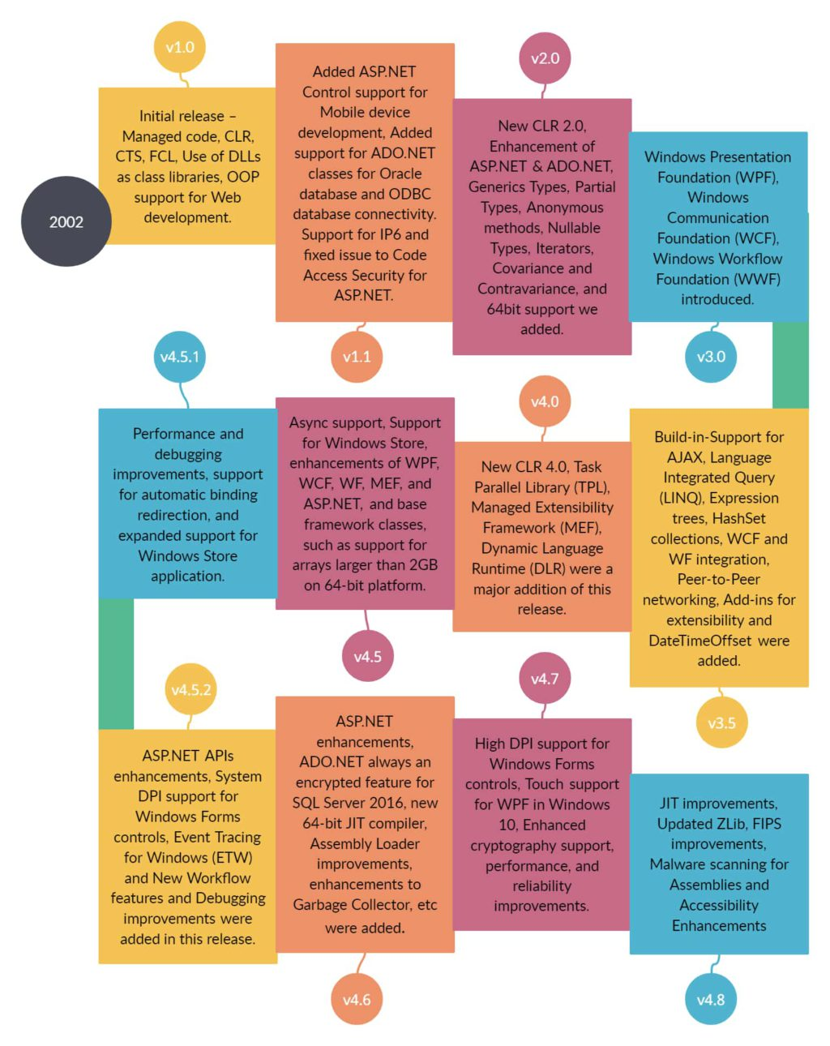
HISTORY

Slide 4
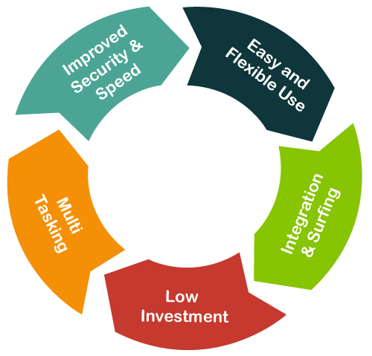
BENEFITS OF .NET FRAMEWORK
Consistent Programming Model :
  Provides a consistent OOP model across different programming languages.
  .NET framework is used to create programs for performing exchange or transfer of data from (or to) databases and files.
Cross Platform Support :
  It enables interoperability between different multiple windows OS.
  Any windows platform that supports CLR can execute .Net application.

Slide 5
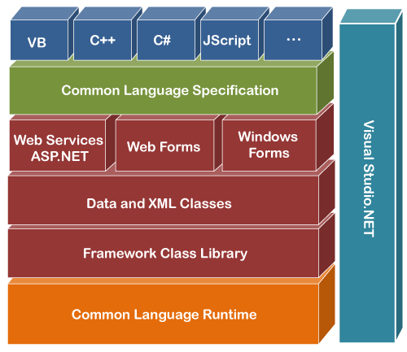
COMPONENTS
Common Language Runtime (CLR)
Framework Class Library (FCL),
Core Languages (WinForms, ASP.NET, and ADO.NET), and
Other Modules (WCF, WPF, WF, Card Space, LINQ, Entity Framework, Parallel LINQ, Task Parallel Library, etc.)

Slide 6
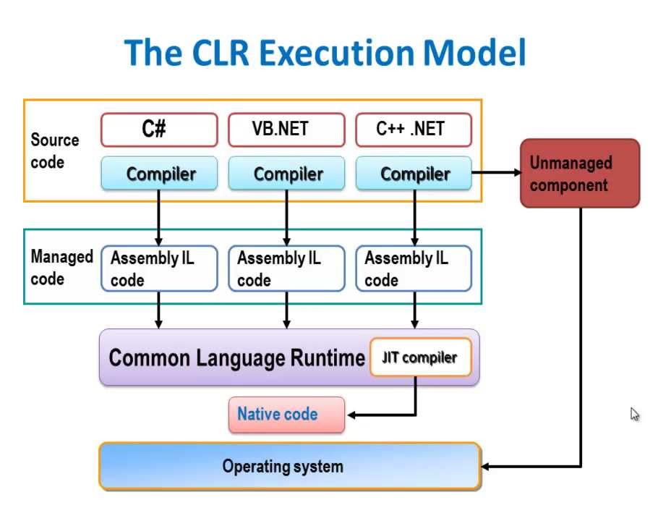
COMMON LANGUAGE RUNTIME (CLR)

Slide 7
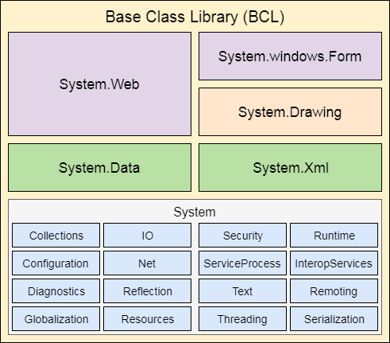
FRAMEWORK CLASS LIBRARY (FCL)
It is a standard library that is a collection of thousands of classes and used to build an application

Slide 8
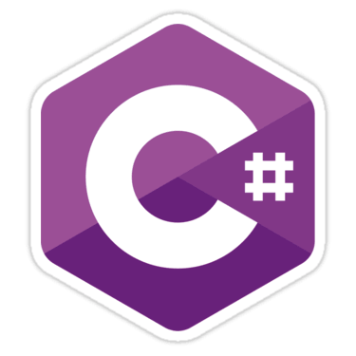
C# LANGUAGE
C# (pronounced as C-Sharp) is a programming language and is used to write software that runs on .net framework.

Slide 9
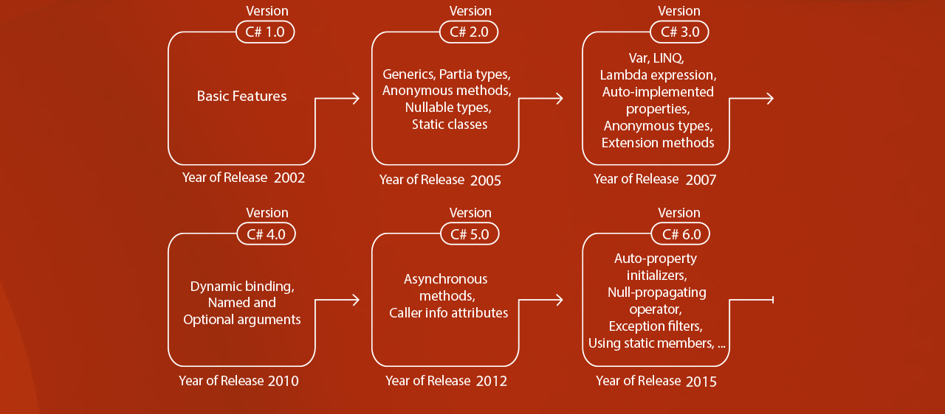
C# VERSION HISTORY

Slide 10
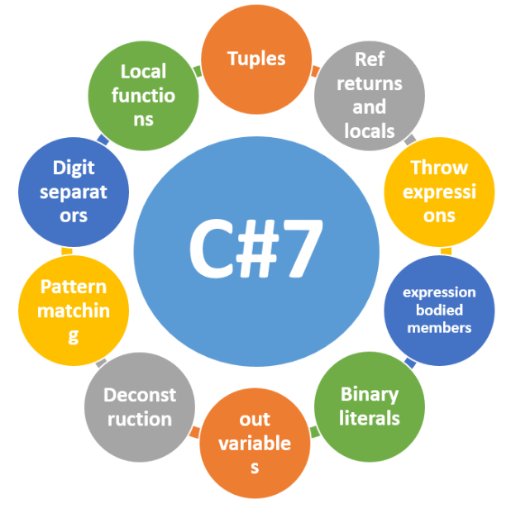
C# FEATURES

Slide 11
THANK YOU

